Slide 1

CSS

Slide 2
What is CSS?
Cascading Style Sheet
Control the look and feel of web documents
Apply one style to many elements
Apply many styles to one element
Apply a set of styles to many documents
Notes:
The word cascading refers to the way css applies style on top of another

Slide 3
Why use CSS?
Separate style from content
Better control over the look and feel
Gain flexibility and consistency
No longer use HTML tags to format a document
Allows you to create rules to control your HTML elements

Slide 4
Levels of CSS
Levels are sometimes called “versions”
CSS level 1
Basic CSS: fonts, color, alignment, margins, borders, etc.
CSS level 2
Positioning, media types, bidirectional text, etc.
CSS level 3
Mainly enhancements
Layout models
Sound
Effects

Slide 5
Using CSS
The style attribute
<p style=“color: red”> This is red. </p>
The <style> tag
For inserting a style sheet in a document
External style sheets
<link rel=“stylesheet” type=“text/css” href=“custom.css” />
Use one style sheet for multiple documents
Use combinations of different style sheets for different purposes
Use external style sheets for most documents
Use <div> and <span> for applying style
Notes:
Div for block elements and span for inline elements
And then show: C1

Slide 6
CSS usage sample
<!DOCTYPE html> <html> <head> <style> body {background-color: powderblue;} h1 {color: blue;} p.test {color: red;} </style> </head> <body>
<h1>This is a heading</h1> <p class=„test“>This is a paragraph.</p> </body> </html>

Slide 7
CSS external css
<!DOCTYPE html> <html> <head> <link rel="stylesheet" href="styles.css"> </head> <body> <h1>This is a heading</h1> <p class=„test“>This is a paragraph.</p> </body> </html>

Slide 8
CSS external css (styles.css)
body { background-color: powderblue; } h1 { color: blue; } p { color: red; }

Slide 9
CSS syntax
Include 2 distinct parts
the selector and the declaration
A selector
Points to the HTML element
A declaration block
Contains one or more declarations separated by a semicolons

Slide 10
CSS syntax
looks like this…
selector
declaration
Element = selector Starts { }
a {
float: left;
}
Each declarations ends ;
property
value
Notes:
After parts Talk about:
1.Comments and whitespace
2.Statements (curly braces and semi colon is essentila otherwise the parser won’t understand), last statement can have no semicolon it works that way.
3.Selector -> next slide

Slide 11
CSS selectors
A selector allows you to
Select and manipulate HTML elements.
CSS selectors are used to ”select" HTML elements
They do that selection based on the element name
For instance
p selector “finds” all <p> tags in HTML and formats it as you declared in CSS
p {
color: red;
text-align: center;
}

Slide 12
CSS selectors
Associate style rules to
HTML elements
Selectors
Indicate which element the rule applies to
Declarations
Indicate how the elements should be styled.
selector
declaration
a {
float: left;
}
property
value

Slide 13
CSS selectors
Universal selector | *{} | Applies to all elements in the document
Tag selector | h1, h2, h3{} | Applies to the tags
Class selector | .shape{} | Applies to elements which indicate class shape
 | .shape a {} | Applies to “a” elements in shape
Id selector | #clear | Applies to element with id=“clear”
 | #clear a p{} | Applies to a and p inside id=“clear”
Child selector | form > input | Applies to input elements inside form
Descendent selector | sidebar p{} | Applies to p element inside sidebar
Attribute selector | input[type="text"] {} | Applies to [type=“text”] inside input
Pseudo selector | a: link {} | Applies to link inside a
Notes:
1.Pseudo selector
2.Descendent selector and attribute selector

Slide 14
CSS measurement units
Unit | Meaning
% | Percentage
in | Inches
cm | Centimeters
mm | Millimeters
px | 1 Pixel

Slide 15
CSS typographical units
Unit | Meaning
em | The vertical size of the font
ex | The “ex-height” of the font (usually about half of em)
pt | 1 point = 1/72 inch
pc | 1 pica = 12 points
Notes:
Em stands for: height of a capital M (I think)
Pc:paices
Pt: points

Slide 16
CSS color properties
color:
Color of the text
background-color:
Color of a box background
border-color:
Color of a border

Slide 17
CSS color values
Unit | Meaning
name | The name of a color
rgb(n, n, n) | An RGB value in decimal
rgb(n%, n%, n%) | An RGB value in percentages
#rrggbb | An RGB value in hexadecimal
#rgb | Shorthand for #rrggbb

Slide 18
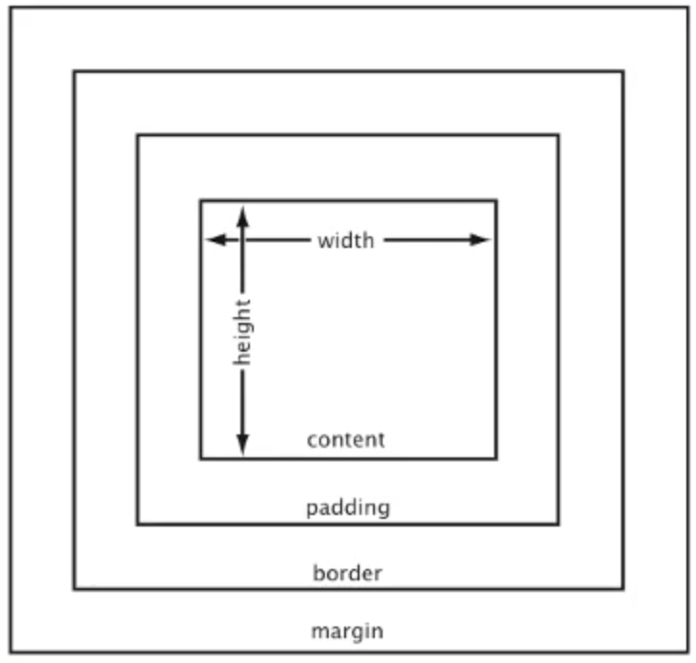
CSS content box model
Total box size = content + padding + border + margin
Notes:
Be careful about Internet explorer and explain that IE (earlier versions) uses quirks mode which is different from the other browsers
Then talk about :
C3
C4
C5
C6

Slide 19
ABOUT borders
border-style:
solid, dotted, dashed, double, groove
hidden / none
border-color
etc.

Slide 20
Z-INDEX
The z-index property specifies the stack order of an element.
An element with greater stack order is always in front of an element with a lower stack order.

Slide 21
Z-INDEX
Value | Description
auto | Sets the stack order equal to its parent. This is default.
number | Sets the stack order of the element. Negative numbers are allowed
Initial | Sets this property to its default value.
inherit | Inherits this property from its parent element.

